Slide 1
Data Management
How to plan, design, and implement
a successful data management program

Slide 2
Table of Contents
Opportunity
Approach
Execution
Case Studies

Slide 3


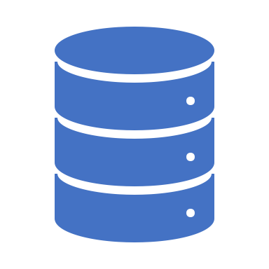

Opportunity – Goals
There are many reasons why organizations seek greater control of their data via data management:
Data management is not just for large corporations, as organizations of all sizes can benefit from better managed and governed data.
Business Goals
Risk Management
Regulatory Compliance
New Technology
Improve data-driven decisions
Cut data management costs
Discover new revenue streams
Improve customer satisfaction
Avoid financial penalties
Avoid reputational loss
Enhance competitiveness
Comply with new regulations
Solve regulatory challenges
Ensure ongoing compliance
Leverage new systems
Leverage new data architecture
Leverage new datasets

Slide 4
Opportunity – Use Cases
It’s often helpful to understand the current situation in terms of a use case:
  How would a person or group use a process or system to accomplish a goal?
Following is a sample data management use case:
  “The Wealth Management division of a large Canadian bank will be provided a full fidelity flat file from a newly implemented Wealth360 system in a Microsoft Azure cloud environment. Wealth wants to recreate key management reports, enable data analytics, and develop predictive analytics capabilities.
  Wealth wants a consultant to help build the right data strategy, data models, and data architecture to ensure it can extract, aggregate, and distribute data across the organization. They want timely and cost-effective access to high quality data so they can use it for business, governance, and regulatory purposes.”

Slide 5
Opportunity – Risks
Potential consequences of inadequate data management:
Reputational Risks for Basel Noncompliance.
  As of July 2018, only 3 banks out of 30 had passed the Basel Committee’s latest review of BCBS 239 compliance. All three are believed to be US banks – one of them JP Morgan. (https://www.risk.net/risk-management/5781976/regulators-bristle-at-slow-progress-on-bcbs-239)
Fines for Data Breaches.
  A report in September 2019 states that banks have been fined $20 billion for various data breaches (https://www.risk.net/comment/6968801/op-risk-data-sanctions-busting-fines-cost-banks-20bn#cxrecs_s)
Penalties for GDPR Noncompliance.
  Effective May 2018, all organizations in any industry that process the personal data of EU residents are regulated by GRPR. The potential penalties for noncompliance can reach as high as 4% of global revenue or 20 million euros (http://www.enforcementtracker.com/)

Slide 6
Approach – Overview
Our approach to standing up a data management program consists of four phases:
Discovery. Understand the business and current situation. Explore challenges, current data management capabilities, and future aspirations.
Planning. Agree a plan and strategy for data management. Identify use cases, conduct deeper technology assessments, and set up appropriate organization.
Design. Develop a technology blueprint. Draft policies, standards, and processes. Select tools to support effective data management.
Implementation. Establish data integration processes and data repositories. Implement data domains and data catalogs. Set up reporting and analytics platforms, tools, and models.

Slide 7
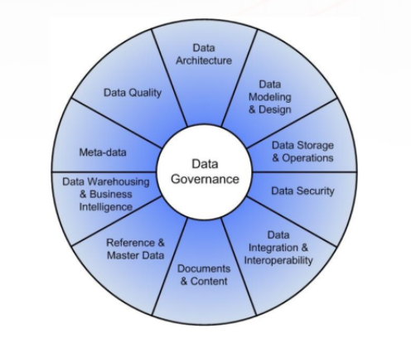
Approach – Discovery
The most important activity during the Discovery Phase is to conduct a Data Management Capability Assessment:
Performing an assessment using DAMA’s DMBOK model is one of the best ways to evaluate data management capability.
This formal review of your data management program helps to identify gaps and agree a list of priorities.
It can also create a common framework, align stakeholders to a shared vision, and build a business case for change.
DAMA’s DMBOK (Data Management Book of Knowledge) Model

Slide 8
Approach – Planning
In the Planning Phase, a Data Strategy is critical to stand up your Data Management function:
  Vision. Compelling vision for data management.
  Business Case. Summary business case and funding model for data management.
  Principles. Guiding principles, values, and management perspectives.
  Objectives. Mission and long-term goals, aligned to business objectives. SMART objectives for the next 12-24 months.
  Measures. Proposed measures to assess data management success.
  Organization. Roles and organizations, along with rights and responsibilities.
  Requirements. Program components and initiatives: data sources & types, analytics, data governance, data infrastructure.
  Target State. Target or future state, along with gap analysis based on current state.
  Program. Prioritized program of work with scope boundaries.
  Roadmap. Implementation roadmap, along with projects, action items, and resources.

Slide 9
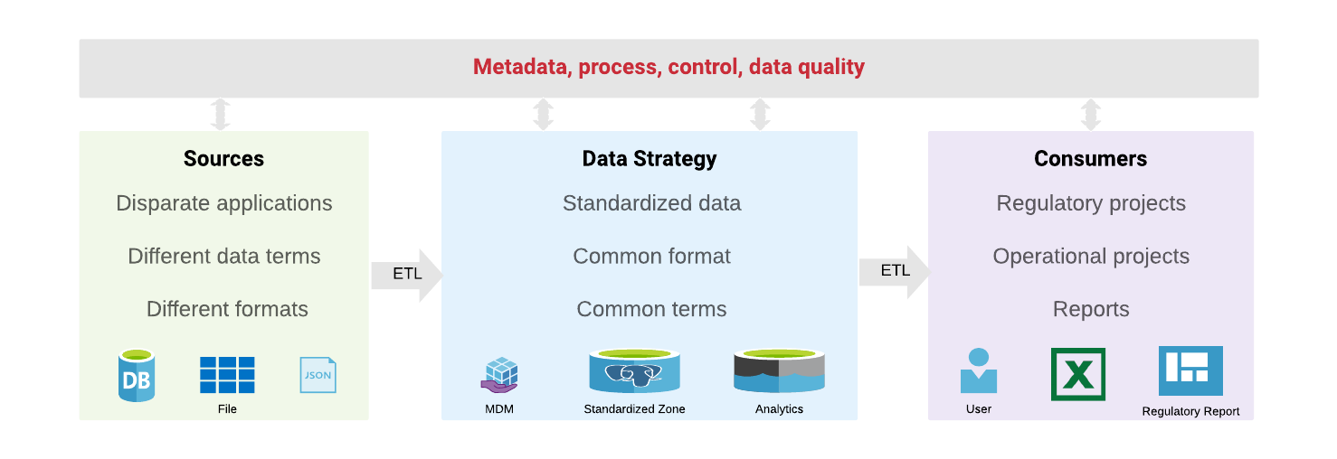
Approach – Design
We design a data management program around the Data Pipeline during the Design Phase:

Slide 10
Approach – Implementation
Strategy
The Implementation Phase focuses on building Data Management Capabilities required for a successful data management program.
The foundational capabilities include:
Analytics. Reporting platforms and reports, advanced analytics tools and models.
Data Governance. Data domains, data catalog with data glossary and dictionary.
Data Infrastructure. Data integration processes, data repositories.
Use Cases
Analytics
Data Governance
Data Infrastructure
BCG Data Capabilities Model

Slide 11






Execution – Project Plan
We implement data management via three workstreams: data pipeline, data governance, and reporting:
Phase 1
Discovery
Phase 2
Planning
Phase 3
Design
Phase 4
Implementation
1. Data
Pipeline
Assess systems, data models, and data architecture
Develop data strategy or assess existing data strategy
Develop blueprint for data pipeline
Implement and monitor ETL data integration processes
Technical assessment of data repositories, tools, ETL processes
Select tools for data ingestion, storage, and integration
Implement operational data stores, data warehouses, data lakes.
2. Data
Governance
Assess data management capabilities, pain points, and gaps
Identify use cases, critical data reports, critical data elements
Draft data policies, standards, and processes
Establish data domains, authoritative sources, provisioning points
Establish data governance committee, stewards, custodians
Select data catalog platform and other governance tools
Populate data catalog
3. Reporting
& Analytics
Assess business objectives and key performance metrics
Rationalize reports based on business priorities
Select enterprise reporting platform
Implement reporting platform and build prioritized reports
Assess datasets for advanced analytics modeling
Identify predictive analytics use cases and opportunities
Develop data collection guide and prepare data for modeling
Develop predictive analytics tools and build models
Outcomes
Initiate project
Understand business & data
Identify pain points & gaps
Develop data strategy
Establish governance organization
Identify priorities & use cases
Design data pipeline
Select data & reporting tools
Draft policies & processes
Data storage and integration
Data catalog
Reports and analytics tools

Slide 12
Execution – Project Team
Name | Role | Qualifications
Rob Straker | Project Lead & Data Governance SME | Experienced management consultant and corporate executive Projects: Data Governance, Regulatory Compliance, Advanced Analytics Certifications: PMP, Lean Six Sigma Black Belt, Agile Courses: Artificial Intelligence, Data Science, Data Engineering MBA, MSc Astronomy, BSc Astrophysics
Jane Estrada | Data Management Professional & Founder at Euryka | Experienced Data Management consultant and enterprise data architect Projects: Capital Markets, Data Management, Enterprise Data Architecture, Euryka Data Catalog Courses: CDMP, OCP BA Computer Science and Political Science
TM7 | Technology Leader & Data Engineer | Canadian software engineering specializing in FinTech products and tools.
Client | Data Analyst | TBD.

Slide 13
Execution – Secrets to Success
Our approach ensures success by building data management practices that are:
Metadata-Driven.
  A good Data Management practice must be metadata driven and have efficient processes in place. Too often organizations jump into building data stores, data warehouses and analytics without metadata or processes.
  The result is a “black box” of data that is hard to understand or trust.
Federated.
  A federated data management practice with a focus on collaboration allows for a nimble but highly efficient data management implementation. The responsibilities are shared between business, IT and data management teams.
  Ownership and responsibilities are clearly divided in a way all relevant parts of the organization feels engaged and responsible for the success of data management strategy.

Slide 14
Case Studies – Big 5 Bank
Challenge:
  Financial regulators discovered that banks were unable to quickly and easily access high-quality data to effectively assess risks, so the Basel Committee on Banking Supervision developed ‘Principals for Risk Data Aggregation and Risk Reporting’.
  OSFI, the Canadian financial regulator, decided to require Canada’s largest banks to comply with these regulations within 3 years, so they had to quickly figure out their roadmaps to compliance, starting with a self-assessment of current capabilities.
  It would be onerous for any large, complex organization to deliver the right data, the right quality, at the right time. But the challenge was greater for this bank, which had fallen behind its peers in technology infrastructure and capabilities.
Solution:
  We recognized that the path to regulatory compliance meant establishing a data governance function at the bank. While the focus would be on risk management, the roadmap would include the entire organization including international units.
  Over 3 years, our team implemented a robust capability roadmap, establishing a data governance organization, building a foundation of policies, and driving real value through new standards, procedures, tools, systems, and data architecture. It was:
    Transformational: Changed the way the bank did business through an accurate, reliable, and timely foundation for analytics.
    Cost-Effective: Designed systems and processes to lower cost by building once for multiple users across the bank.
    Customer-Driven: Improved customer insights, reduced costs, and better decision-making to serve customers.
Results:
  The bank achieved its compliance target, receiving praise from OSFI for implementing a peer-leading set of capabilities.
  A new and vital data governance function was created, led by the bank's first Chief Data Officer.
  Executives gained confidence in data-based decisions, and the bank realized cost efficiencies and productivity improvements.

Slide 15


Case Studies – Big 5 Bank
Phase 1:
Initiate Program
Phase 2:
Build Foundation
Phase 3:
Drive Value
Phase 4:
Enhance Value
1. Enterprise Data Governance
Assess current situation, conduct capability assessment, and perform gap analysis.
Draft data strategy and identify data management business requirements.
Appoint Chief Data Officer and establish data governance working group.
Evaluate and improve performance of governance council and working groups.
Create data governance vision and identify business objectives.
Establish data governance council, target operating model, and domain working groups.
Draft standards for data lineage, data quality, metadata, and logical and physical models.
Evaluate and improve policies, standards, and procedures as required.
Build data governance business case and agree funding model.
Develop data policy framework and draft all enterprise data policies.
Define processes for data quality testing and service level agreements registration.
Expand data governance to international business units.
Develop data governance program charter, framework, and roadmap.
Define data domains, critical reports, critical measures, and critical data elements.
Document data lineage for critical data elements, establish business glossary & data dictionary.
2. Regulatory Compliance
Conduct enterprise-wide annual self-assessment for risk data and reporting.
Develop control processes for IT automation, end user computing, and manual processes.
Identify and implement compliance assessment monitoring and reporting tool.
Mature and expand data lineage, data quality, and stress testing activities.
Establish regulatory compliance framework and develop compliance assessment tool.
Develop frameworks for stress testing and risk report reconciliation.
Develop and implement second line of defense organization and process.
3. Advanced Infrastructure
Develop enterprise data lake principles for data acquisition, classification, consumption.
Draft enterprise data lake (EDL) conceptual and reference architectures.
Execute EDL target operating model and complete data migration.
Gain stakeholder buy-in and approval for establishment of an enterprise data lake.
Implement core components of EDL Hadoop operational readiness.
Understand Rational for Journey
Data is a strategic asset that can lead to a competitive advantage.
Higher quality data will improve decision making, innovation and customer analytics.
Ensure Regulatory Compliance
Regulatory compliance cannot be met with current data management capabilities.
Establish data leadership & ownership
Data stewards are accountable, data custodians are responsible for data issues.
Teams empowered with better understanding of data, from flows to quality metrics.
Improve efficiency
Designed for low cost by building systems and processes once for multiple users.
Support key business drivers
Customer: Enhanced insights & experience with reliable, timely, and accurate data.
Efficiency & Effectiveness: Designed for lower cost and higher productivity.
Capital Management: Improved capital management and assignment.
Leadership: Improved decision-making quality and speed.
Improve effectiveness
Fine-tuned organization and artifacts.
Broaden scope
Expanded focus to include international business units.
Broadened list of critical reports, critical data elements, and quality thresholds.
Business Outcomes
Notes:
Intro
This was a wide-ranging, 3-year engagement
4 distinct phases of development
Initiate Program
Make the case + connect to biz + plan the roadmap
Outcome: data is a strategic asset
Build Foundation
Organization + policies/principles + focus
Outcome: Accountability + empowerment
Drive Value
Standards + Procedures + Tools
Outcomes: customer + efficient + leadership
Enhance Value
Fine-tune + expand
Outcomes: effectiveness + scope
Questions
Where is CIBC in this journey?
Does this resonate?
Are there items here more important than others?

