Slide 1


EURYKA
Data Management Inc.
Specializing in federated metadata driven data management

Slide 2

Jane Estrada
Founder, Euryka Data Management Inc.
jane.estrada@eurykadm.com

Slide 3


Agenda
Introductions
Jobs you need to do
Benefits gained from Euryka
Euryka features
Differentiators
Next steps

Slide 4

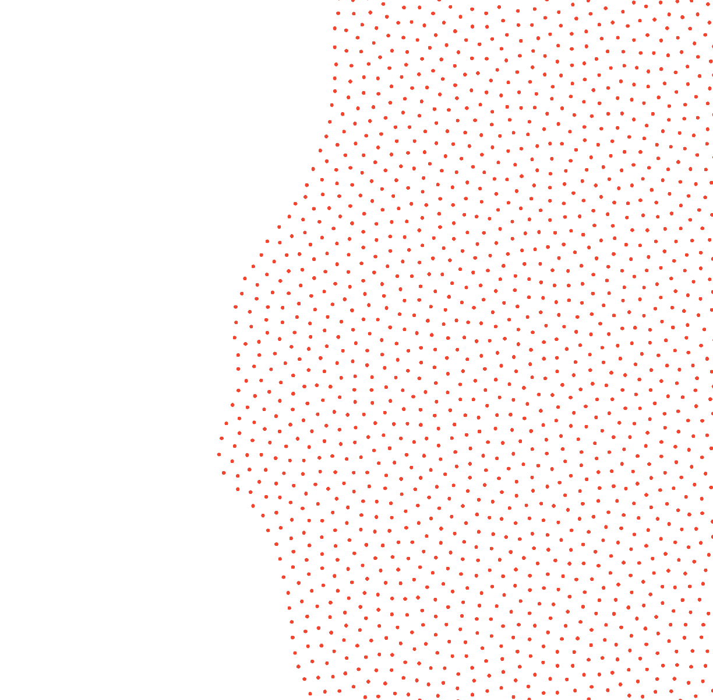
Our customers have data jobs to do

Slide 5


Here are some of the daily data centric jobs our customers need to get done
Maintain reports to satisfy regulators and to make good business decisions
Mitigate reputational and profit loss by managing risk
Deliver strategic projects on time and on budget
Get a complete view of customers so strategic decision making is possible
Eliminate redundant data and processes to minimize maintenance costs

Slide 6
How we help our customers

Slide 7

Step by step our customers become a data driven organization
Facilitate data governance
Insights into data
Lineage to track data integration
Standardize language for business terms
Identify sensitive or private data
Facilitate faster data analysis required for projects delivery
Easy access to information about data sources and data elements

Slide 8
Our Software Features

Slide 9
Introduction to Euryka
  Euryka Data Management offers a data catalog tool designed & developed by data professionals to solve data governance problems.
  Simple user-friendly platform.
  No rigid frameworks to follow. Add whatever metadata is available and iterate as you learn more about data.
  All organizations are unique. With that in mind, we offer services and products that are fit for purpose and customizable to your operations, leaving behind the one size fits all approach.

Slide 10
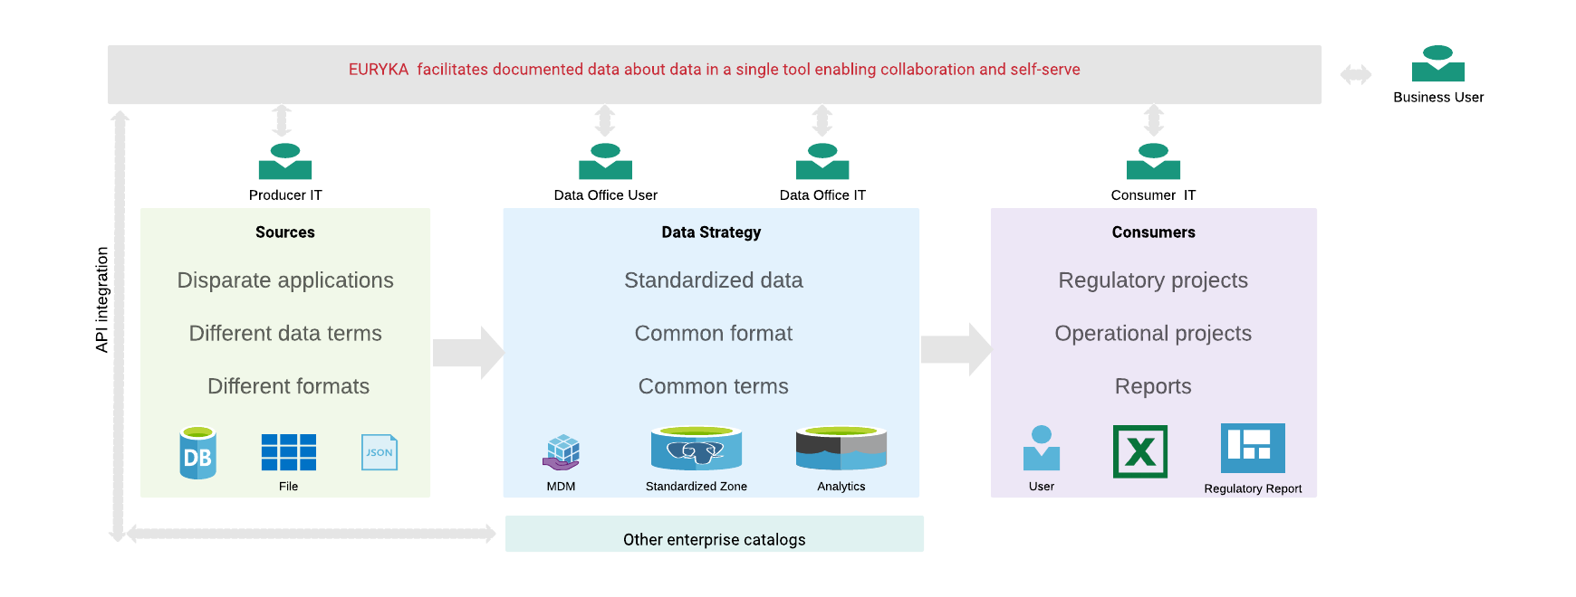
Federated Collaboration

Slide 11
Data Driven Project Implementation
Data Office enables, approves and facilitates
Step 1:
Understand requirement
Step 2:
Define common model
Step 3:
Create mappings
Step 4:
Develop
Step 5:
Validate
Step 6:
Publish
Step 7:
Accessible information about data
Source Analyst
Inputs the source information
Data Modeller
Creates or updates common data model
Source Analyst Creates source to common data model mappings
Developer
Develops using specifications
Tester
Tests data quality according to specifications
Consumer
Creates consumer information
All users
Browse Euryka to see what is available
EURYKA

Slide 12
How are we different?

Slide 13



How is Euryka Different?
  Creating accurate reports for regulators and executives
  Identify sensitive data
  Maintain good quality data
  Deliver integration projects on time
  Get 360º view of customer data or product related data to enable strategic decisions
  Eliminate redundant data and processes to minimize maintenance costs
  There are several large vendors such as IBM, Informatica and Collibra in the market. These vendors don’t cater to smaller organizations
  Other tools such as Azure Purview is targeted to catalog a specific set of data sources
  The price is too expensive, limiting accessibility.
  The solutions require costly training because user interface is not easy to understand
  Simple, business friendly design eliminating the need for costly training
  Licensing structure that facilitates decentralized metadata collection.
  Fit for purpose solution. Continuous feature enhancement based on user feedback
Data Management Problems
Today’s Solutions
Our Solution

Slide 14
Our Approach
  1 or 2 month free trial
  One hour training to get started
  Use the tool and identify gaps
  Prioritize resolution to the identified gaps. Some features may be absorbed in the licensing cost while others may incur one time charge. Any features that fall outside the metadata realm won’t be adopted.
  Agreed upon new features will be scheduled and delivered in agile fashion after license is finalized.
  New features will be made available as we evolve Euryka throughout the life of the license
  Support is always an email away!

Slide 15

Thank You!

Slide 16
Case Study 1 – Big 5 Canadian Bank
Challenge:
  Financial regulators discovered that banks were unable to quickly and easily access high-quality data to effectively assess risks, so the Basel Committee on Banking Supervision developed ‘Principals for Risk Data Aggregation and Risk Reporting’.
  OSFI, the Canadian financial regulator, decided to require Canada’s largest banks to comply with these regulations within 3 years, so they had to quickly figure out their roadmaps to compliance, starting with a self-assessment of current capabilities.
  It would be onerous for any large, complex organization to deliver the right data, the right quality, at the right time. But the challenge was greater for this bank, which had fallen behind its peers in technology infrastructure and capabilities.
Solution:
  We recognized that the path to regulatory compliance meant establishing a data governance function at the bank. While the focus would be on risk management, the roadmap would include the entire organization including international units.
  Over 3 years, our team implemented a robust capability roadmap, establishing a data governance organization, building a foundation of policies, and driving real value through new standards, procedures, tools, systems, and data architecture. It was:
    Transformational: Changed the way the bank did business through an accurate, reliable, and timely foundation for analytics.
    Cost-Effective: Designed systems and processes to lower cost by building once for multiple users across the bank.
    Customer-Driven: Improved customer insights, reduced costs, and better decision-making to serve customers.
Results:
  The bank achieved its compliance target, receiving praise from OSFI for implementing a peer-leading set of capabilities.
  A new and vital data governance function was created, led by the bank's first Chief Data Officer.
  Executives gained confidence in data-based decisions, and the bank realized cost efficiencies and productivity improvements.

Slide 17
Case Study 2 – Small Pension Fund
Challenge:
  Generating reports were difficult due to poor data quality
  Without accurate reports, senior management struggled to get insights into the business
Solution:
  After conducting working sessions, there was general agreement to create a data management practice
  Over 1 year, the team implemented a robust data management roadmap, establishing a data governance function, building an operational data store, data mart and establishing data quality checks. It was:
    Transformational: Changed the way the pension fund did business through an accurate, reliable, and timely foundation for analytics.
    Metadata-Driven: Improved data insights, faster implementation, knowledge sharing
Results:
  A new and vital data governance function was created, led by the Data Management team
  Executives gained confidence in data-based decisions using reliable analytics

